Slide 1

Science Lab
Credit: NASA
Looking for the Unknown
Institute of Astrophysics of the Canary Islands Sebastián Hidalgo – Enric Palle – Diego Hidalgo David Rodríguez – Martin Abbott – Alberto Marcos – Santiago Porras

Slide 2
What is the Science Lab?
A non profit lab being deployed worldwide
Attendees collaborating on a non profit cause
Hundreds of compute years in just one day
Previous science labs:
Type 2 Diabetes
Breast Cancer
Star formation and Galaxies

Slide 3
2019’s Science Lab Exoplanet hunting

Slide 4
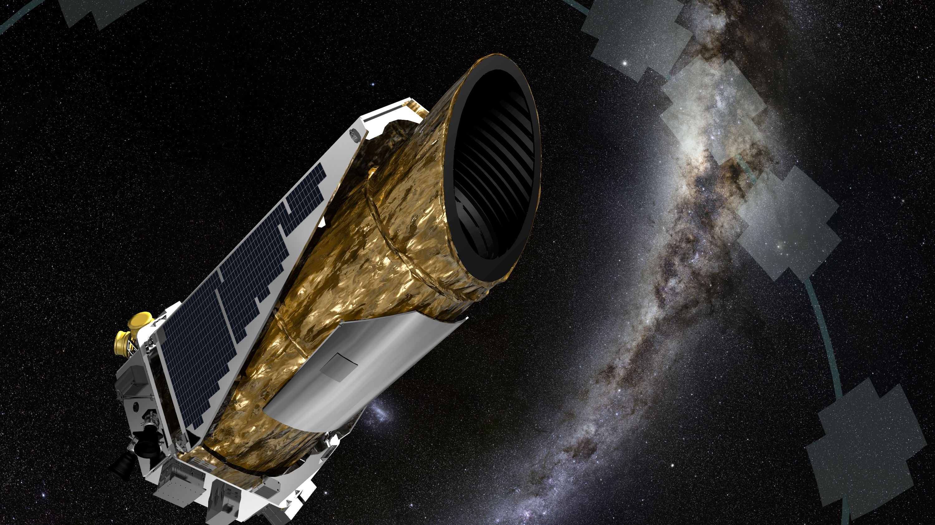
The Kepler Spacecraft
The spacecraft was retired on October 28th 2018
Huge amount of data to analyze¹, that have been already analyzed by NASA and other organizations
Around 1.000 exoplanets have been obtained
The analysis looks for objects such as planets, giant comets, trojan asteroids or unclassified objects (they are there, but nobody knows what they are)
Scientific community is sure there are more objects hidden on Kepler data
For example planets that have gone unnoticed, satellites on other planets, asteroids, comets and event objects that are difficult to explain.
¹ https://keplerscience.arc.nasa.gov/data-products.html

Slide 5
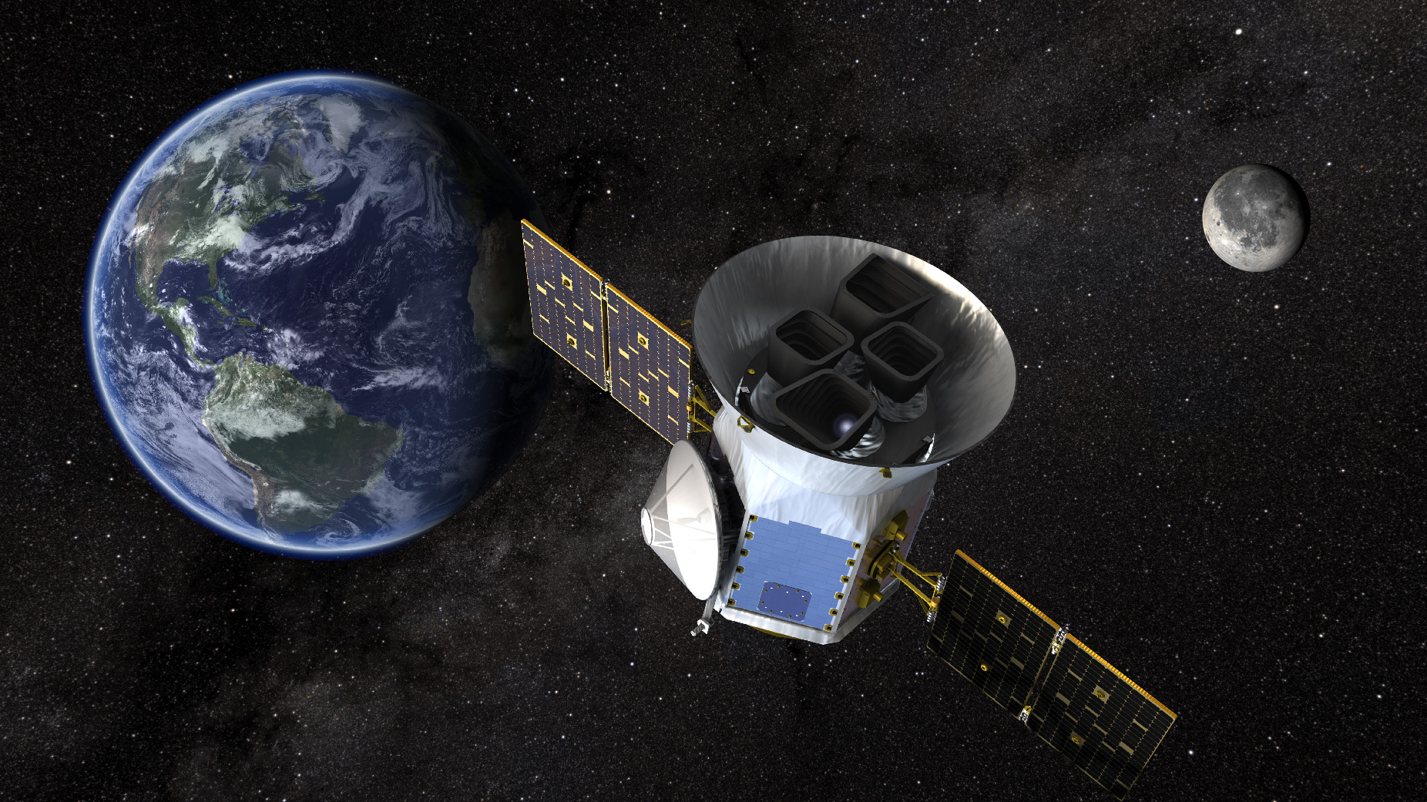
The TESS Spacecraft
Transiting Exoplanet Survey Satellite
Launched on April 18th 2018 to replace Kepler
Space telescope for NASA’s Explorers program
Designed to search for exoplanets
Uses transient method in an area 400 times larger than that covered by Kepler mission
Expected to find more than 20K exoplanets in 2 years
That is more than the 3.800 exoplanets known when it launched
https://heasarc.gsfc.nasa.gov/docs/tess/

Slide 6

Notes:
Video available with subtitles at https://www.youtube.com/watch?v=Q4KjvPIbgMI

Slide 7

The Tabbi’s Star
Not only exoplanets…
Tabbi’s Star and the alien megastructures
As example of a deeper analysis, is the Tabbi’s Star and the alien megastructures that were so famous a year ago
Any new detected object would have a world-class impact

Slide 8

Notes:
Video available with subtitles at https://www.youtube.com/watch?v=C8MLgLC51C8

Slide 9
Science Lab Deployment Details

Slide 10
The Science Lab
Process and Analyze TESS mission data
Process data directly obtained from NASA’s live repository¹
Search for exoplanets by using a machine learning algorithm pre-trained with Kepler’s data
By deploying an automated Docker container
No scientific knowledge needed to deploy the lab, just follow the deployment instructions
Results will be published in a main Astronomy journal
¹ https://heasarc.gsfc.nasa.gov/docs/tess/data-access.html

Slide 11

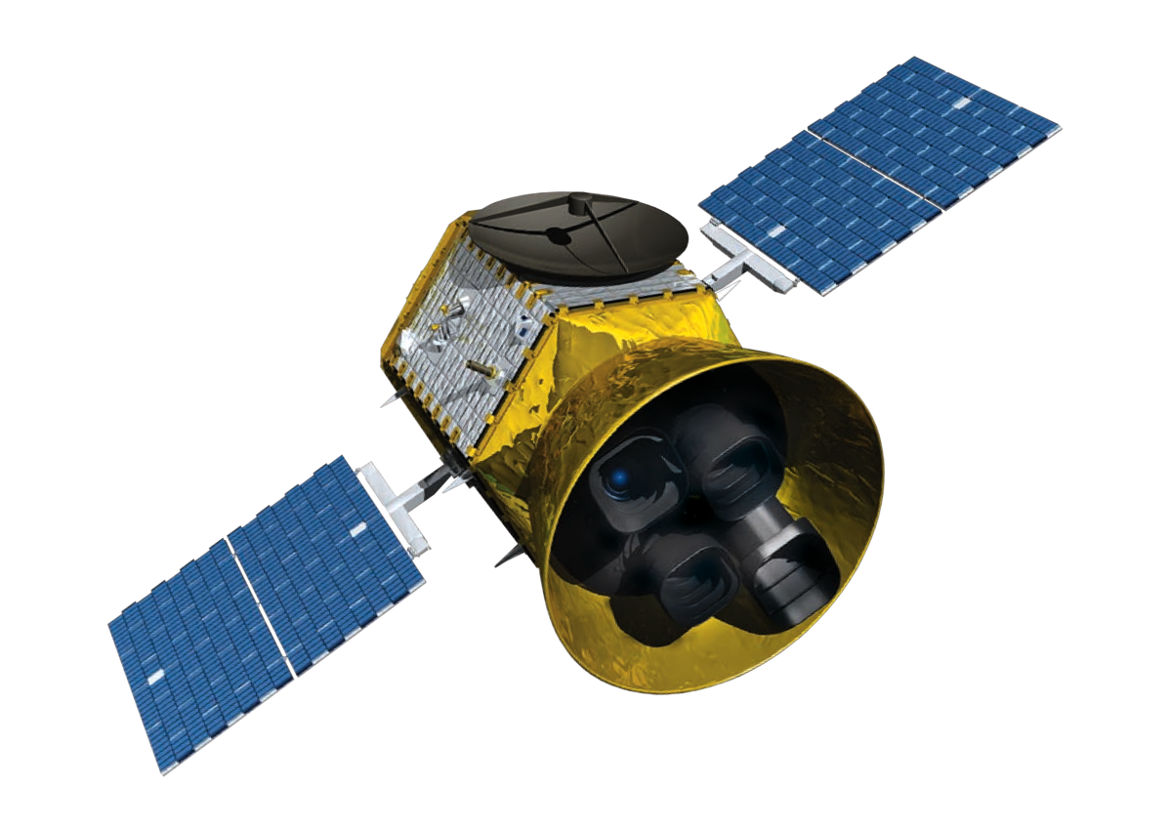
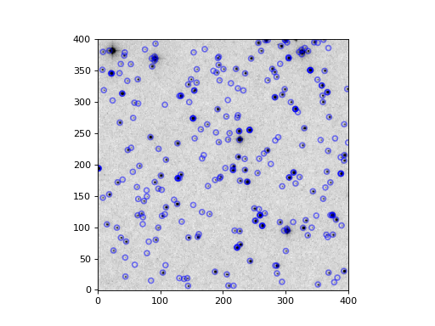
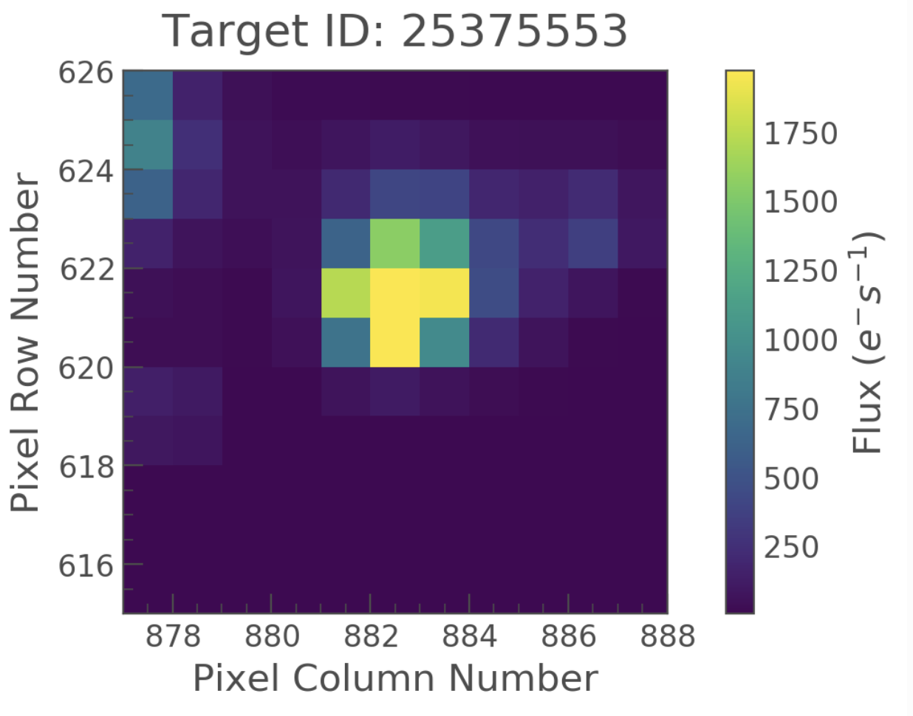


Continuously feeding the lab with live data
Data Pre-processing
Stars Catalog
To Azure Storage
Process each FFI for Star Detection (coordinates & magnitude) ¹
SQL Azure Database with Star coordinates & magnitude
AstroCut ² tool for splitting the FFIs into start “target” files (TPFs)
TPFs (Target Pixel Files)
10x10
FFIs (Full Frame Images) are grouped by Sectors. Each month (approx.) a new sector is made available for download. At time of writing, there are 7 sectors available for downloading and processing. More info at https://heasarc.gsfc.nasa.gov/docs/tess/data-access.html
¹More info at https://photutils.readthedocs.io/en/stable/detection.html
² https://astrocut.readthedocs.io

Slide 12
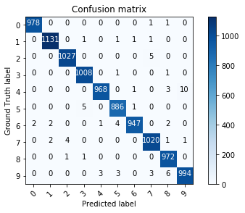
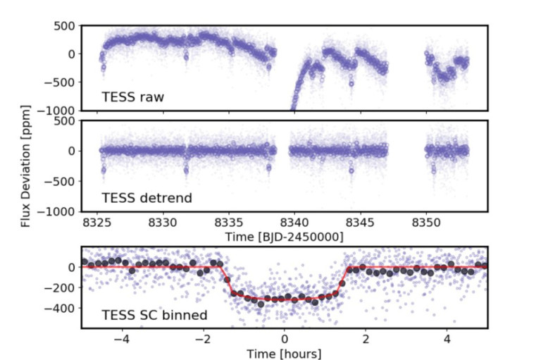
GAB Science Lab “pipelines”
Pipeline 1
Pipeline 2
TPFs (Target Pixel Files)
10x10
Light Curve Files
Result of the ML algorithm searching for exoplanets
Pipelines = algorithms implemented on the GAB client
Pipeline 1: generates light curves from TPFs
Pipeline 2: analyze the light curves searching for exoplanets using ML
Notes:
Python app.py –I s00000101283737823.bin –od outputfolder

Slide 13
The Science Lab Architecture
Lab Server hosted on Azure
Orchestrates the delivery of data to the Lab clients
Lab Client running on Docker containers
Deploy on Azure Container Instances, on your laptop by using Docker Desktop, or on any other Docker powered environment.
Runs the ML algorithms
The lab will continue working after the Global Azure Bootcamp day (expect more Docker images for different flavors (CPU optimized, GPU optimized, etc.) in the future)
Global Dashboards
Just for fun, check how is your progress compared with other locations around the world.

Slide 14

Deployment instructions
http://bit.ly/GAB2019ScienceLab
Support through GAB forums

Slide 15
Proposals for 2020’s science lab?
Non profit
Research for the future of the humanity
Huge quantity of data to process
Ability to run in batches
Real time simulations doesn’t fit well
Contact: global@azurebootcamp.net for proposals

Slide 16
Credits
Special thanks to the people that has invested their invaluable time on building this project for the future of the humanity.
Sebastián Hidalgo, Dr. Astrophysics, Institute of Astrophysics of the Canary Islands (working on the ML pipeline)
Enric Pallé, Dr. Astrophysics, Institute of Astrophysics of the Canary Islands (exoplanet research team)
Diego Hidalgo, Master’s Degree in Astrophysics, Institute of Astrophysics of the Canary Islands (working on the light curves pipeline)
David Rodriguez, CTO at Intelequia, Azure MVP & Regional Director (project coordinator, TESS data processing)
Martin Abbott, Solution Architect at Insight, Azure MVP (project coordination)
Alberto Marcos, Higher Education Account Executive, Microsoft Iberica (TESS data processing)
Victor Calero, Software Engineer, Intelequia (video production)
Santiago Porras, Innovation Team Leader at Encamina (Global Dashboards)

